Slide 1
Voxel-based approach for object detection in point clouds
INF592 – Research internship
Duc-Thinh NGO Ecole Polytechnique
Supervised by: Maxime KIRGO EDF R&D/PERICLES/I2C
01/04/2021 - 31/08/2021

Slide 2
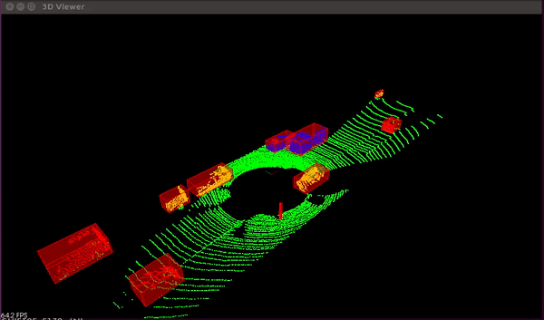
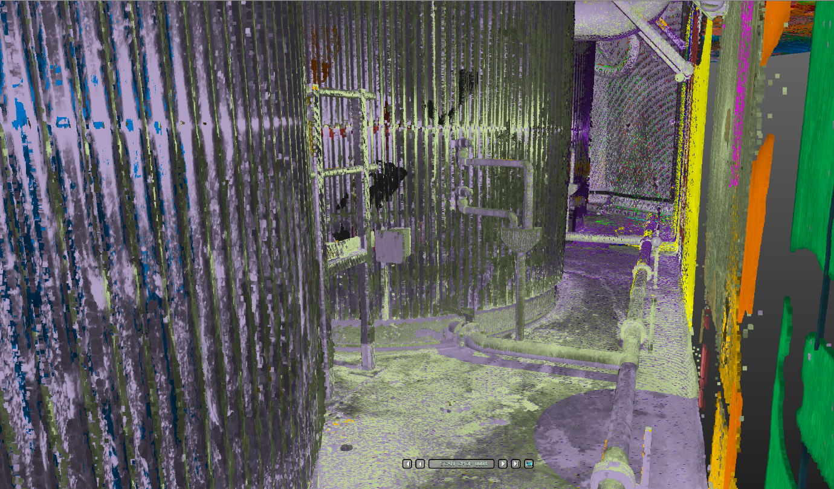
3D Object detection on KITTI Dataset.
Source: enginBozkurt/LidarObstacleDetection: Lidar Obstacle Detection (github.com)
LiDAR point cloud of a boiler room (EDF)
Voxel-based approach for object detection in point clouds
Notes:
3D OD in PCs well known. Ranging from outdoor driving scenes to indoor scenes
Provided with a number LiDAR scans from EDF featuring a boiler room
Obj: detect objs

Slide 3
Plan
Literature review
Data analysis and processing
Description of models
Qualitative results
Qualitative results
Voxel-based approach for object detection in point clouds

Slide 4
Plan
Literature review
Voxel-based approach for object detection in point clouds

Slide 5
Literature review
2D Object detection pipelines
Two-stage
Single-stage
Voxel-based approach for object detection in point clouds
Notes:
classified

Slide 6
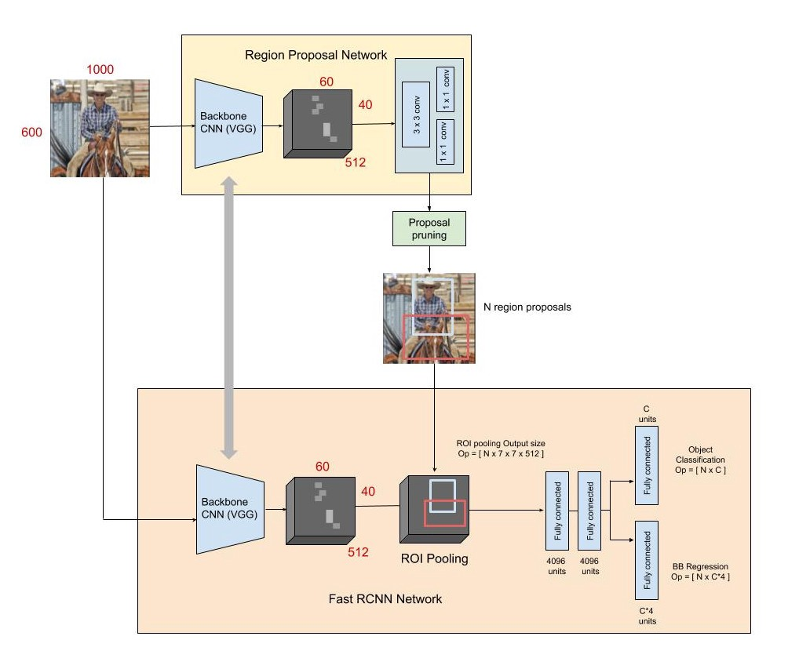
Literature review
2D Object detection pipelines
Two-stage:
Region Proposal Network (RPN)
Fully Connected Network (For prediction refinement)
Faster R-CNN framework.
Source: https://towardsdatascience.com/faster-r-cnn-for-object-detection-a-technical-summary-474c5b857b46
Voxel-based approach for object detection in point clouds
Notes:
Faster r-cnn is a typical two-stage detector framework
It includes: 1. RPN extract features and generate RoIs
2. Perform RoI pooling to extract features for RoIs and apply FCN to …

Slide 7
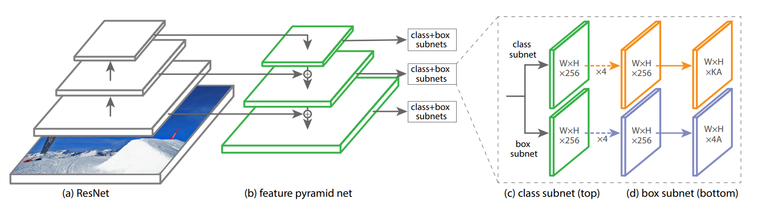
Literature review
2D Object detection pipelines
Single-stage: Multi-scale predictions
RetinaNet.
Source: Tsung-Yi Lin, Priya Goyal, Ross Girshick, et al. “Focal Loss for Dense Object Detection”.
In: Proceedings of the IEEE International Conference on Computer Vision (ICCV). 2017.
Voxel-based approach for object detection in point clouds
Notes:
Single-shot is another commonly-used pipiline for object detectors.
Among them, retinanet is a framework I studied in my project. It features a FPN with multi-scale predictions.

Slide 8
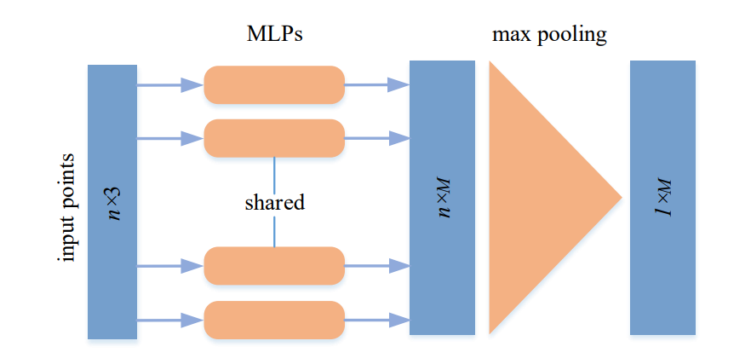
Literature review
Point-based approaches
Process raw point clouds
Local aggregation operators:
Pointnet/Pointnet++
The global aggregation operator in Pointnet.
Source: Y. Guo et al. “Deep Learning for 3D Point Clouds: A Survey”. In CoRR abs/1912.12033 (2019)
Voxel-based approach for object detection in point clouds
Notes:
Process raw pcs, i.e. point coordianates with their features
Pioneering works: a module to encode and aggregate features for a point cloud

Slide 9
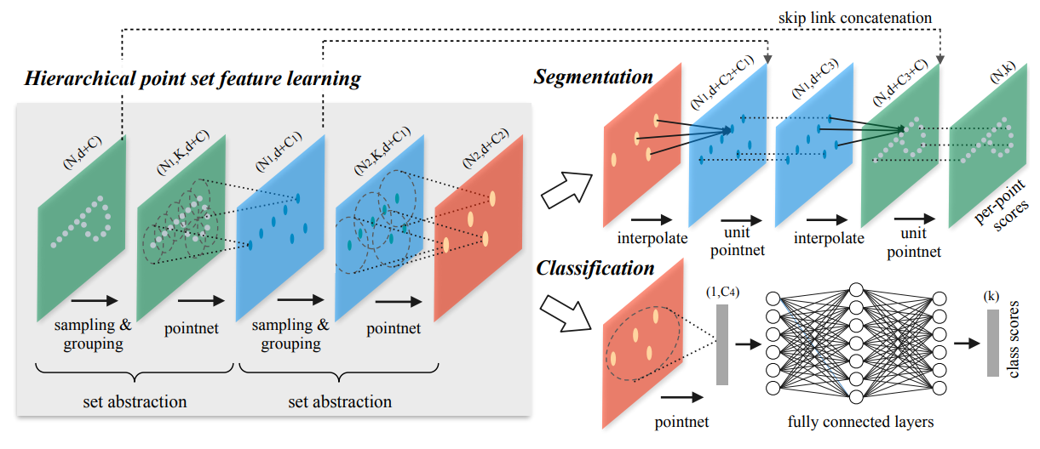
Literature review
Point-based approaches
Process raw point clouds
Local aggregation operators:
Pointnet/Pointnet++
Pointnet++ architecture.
Source: Charles Ruizhongtai Qi, Li Yi, Hao Su, et al. “PointNet++: Deep Hierarchical Feature Learning on Point Sets in a Metric Space”. In: CoRR abs/1706.02413 (2017)
Voxel-based approach for object detection in point clouds

Slide 10
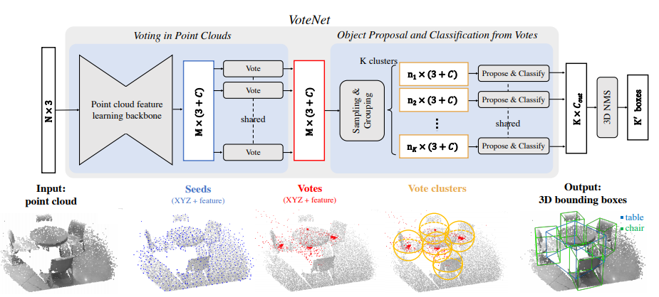

Literature review
Point-based approaches
Process raw point clouds
Local aggregation operators
Votenet $⇨$ Points of Interest
Votenet framework.
Source: Charles R Qi, Or Litany, Kaiming He, et al. “Deep Hough Voting for 3D Object Detection in Point Clouds”. In: Proceedings of the IEEE International Conference on Computer Vision. 2019.
Voxel-based approach for object detection in point clouds
Notes:
Voting mechanism to predict center points of objs -> relate to PoIs

Slide 11

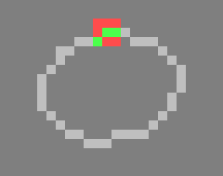
Literature review
Voxel-based approaches
Embed points into a voxel grid
Local aggregation operators:
(Submanifold) Sparse Convolution
Implementations: MinkowskiEngine, Spconv (SECOND)
Normal convolution (Left) compared with Sparse convolution (Right) on sparse data.
Source: Benjamin Graham and Laurens van der Maaten. “Submanifold Sparse Convolutional Networks”. In: CoRR abs/1706.01307 (2017).
Voxel-based approach for object detection in point clouds
Notes:
Normal convolution operator reduces the sparsity whereas the sparse convolution preserves the the sparsity

Slide 12
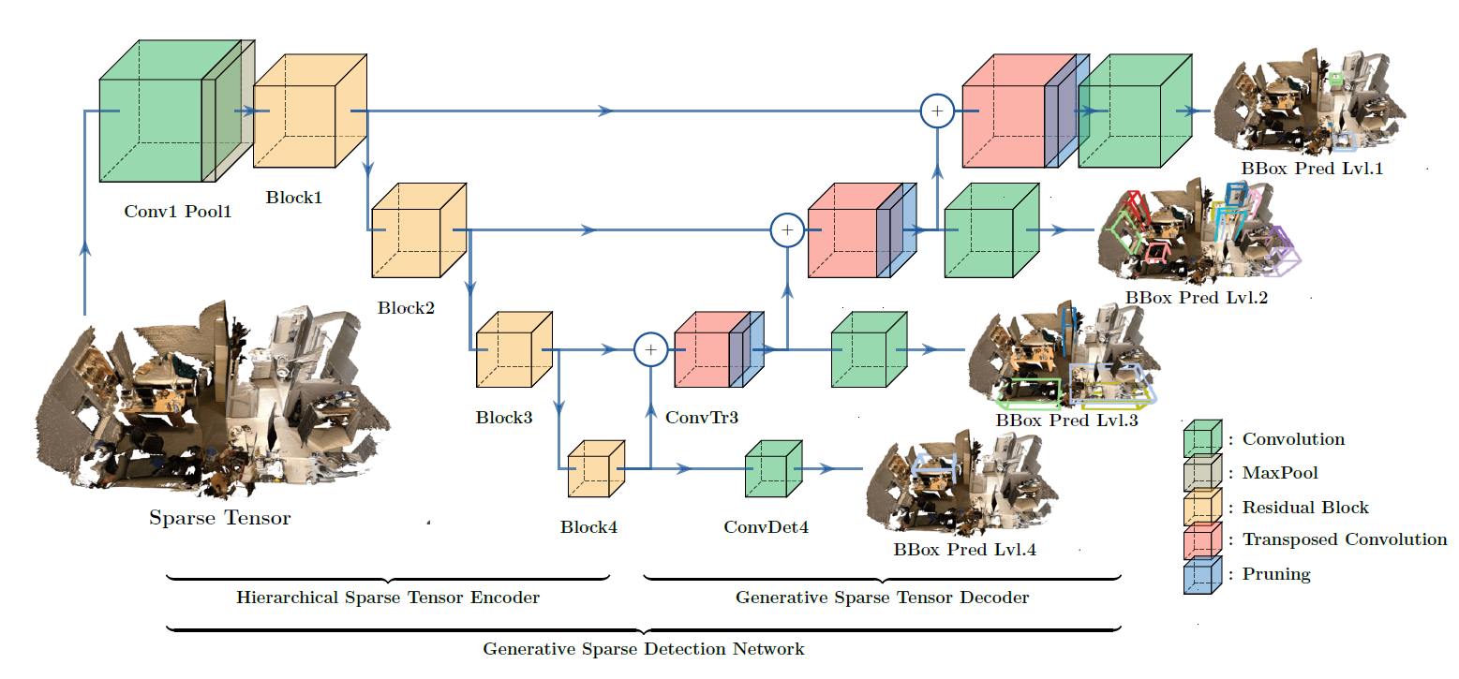
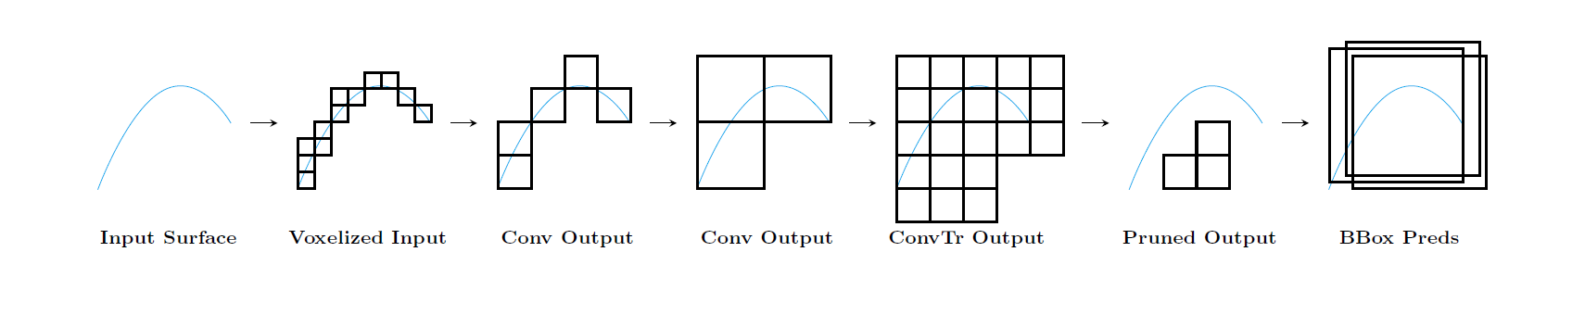
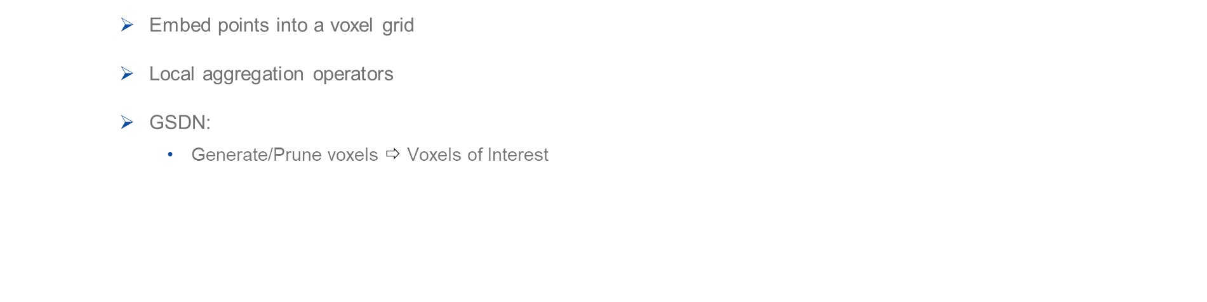
Literature review
Voxel-based approaches
Embed points into a voxel grid
Local aggregation operators
GSDN:
Generate/Prune voxels $⇨$ Voxels of Interest
GSDN architecture with its generate-prune module (below).
Source: JunYoung Gwak, Christopher B Choy, and Silvio Savarese. “Generative Sparse Detection Networks for 3D Single-shot Object Detection”. In: European conference on computer vision. 2020.
Voxel-based approach for object detection in point clouds
Notes:
Leverage the FPN and multi-scale prediction.
Generate voxels with generative transposed convolution – Prune and only VoIs left for prediction

Slide 13
Literature review
Point-based
Voxel-based
Process raw point clouds
Pointnet/ Pointnet++
Votenet
Process voxel grids
Sparse convolution
GSDN
Voxel-based approach for object detection in point clouds
Notes:
Brief comparison of two approaches

Slide 14
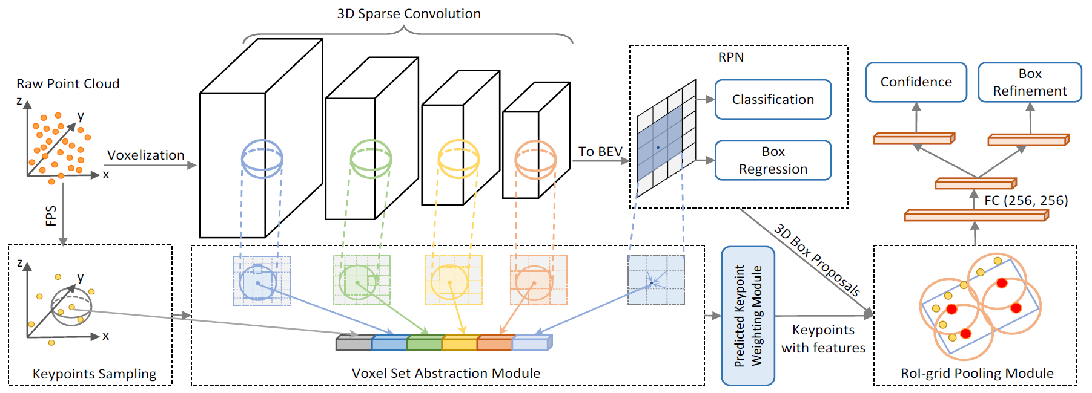
Literature review
Fusion-based approaches
Process both raw point clouds and voxelized data
PV-RCNN
PV-RCNN pipeline.
Source: Shaoshuai Shi, Chaoxu Guo, Li Jiang, et al. “PV-RCNN: Point-Voxel Feature Set Abstraction for 3D Object Detection”. In: CoRR abs/1912.13192 (2019).
Voxel-based approach for object detection in point clouds
Notes:
Above branch extracts 3D features, reshape 3D feature maps into BEV fms, generate BEV proposals
Below branch samples keypoints from raw pc, leverage extracted 3D features to retrieve keypoint features and predict whether they are fg/bg
RoI pooling operator to extract RoI features and feed through a FCN to perform final refinements for predictions

Slide 15
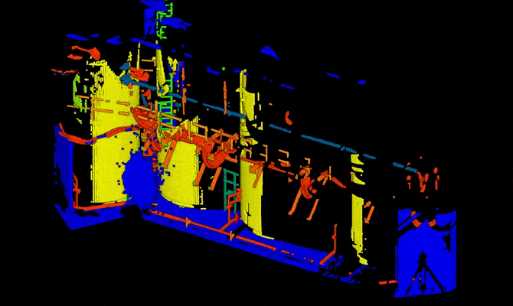
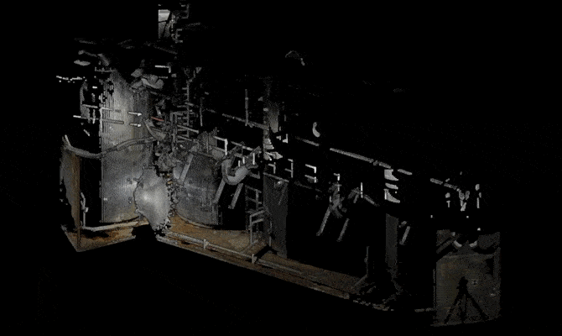
Plan
Literature review
Data analysis and processing
Dataset Chaufferie: a point cloud segmented (Left) and RGB colors (Right)
Voxel-based approach for object detection in point clouds

Slide 16
Data analysis and processing
Outdoor scenes
Indoor scenes
On large scale: (KITTI)
X-axis: [0, 70.4]m
Y-axis: [-40, 40]m
Z-axis: [-3, 1]m
Objects are sparsely distributed
PV-RCNN
On smaller scale:
Camera range: [0.5, 5]m (Sun-RGBD)
A variety of objects in a small scene (room)
GSDN
Voxel-based approach for object detection in point clouds
Notes:
In large-scale outdoor scenes, just a few object classes of interest: . Distributed sparsely.
We can find a variety of objects… such as room of 5x5m.
Each object detector can only resolve a class of dataset.

Slide 17
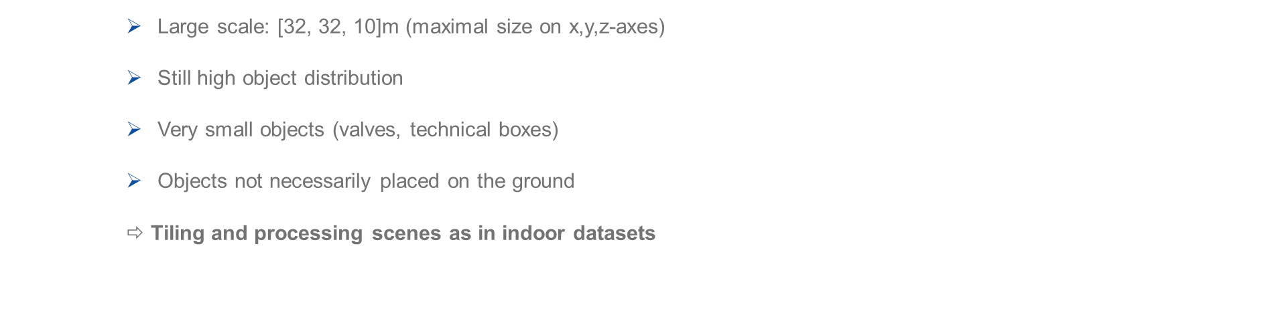
Data analysis and processing
Chaufferie dataset
Large scale: [32, 32, 10]m (maximal size on x,y,z-axes)
Still high object distribution
Very small objects (valves, technical boxes)
Objects not necessarily placed on the ground
$⇨$ Tiling and processing scenes as in indoor datasets
Voxel-based approach for object detection in point clouds
Notes:
To split it into several rectangular sub-scenes

Slide 18
Plan
Literature review
Data analysis and processing
Description of models
Voxel-based approach for object detection in point clouds

Slide 19
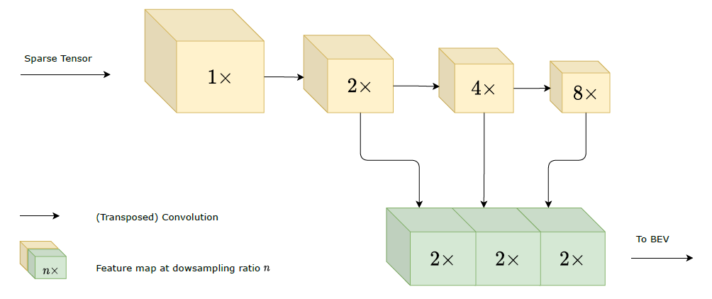
Description of models
PV-RCNN and variants
Problem 1: Resolution of feature maps ⇨ Upsample the final feature maps
3D Backbone of Voxelnet
Voxel-based approach for object detection in point clouds

Slide 20

Description of models
PV-RCNN and variants
Problem 1: Resolution of feature maps $⇨$ Upsample the final feature maps
Results on Sun-RGBD
Method | Bathtub | Bed | Bookshelf | Chair | Desk | Dresser | Nightstand | Sofa | Table | Toilet | mAP
GroupFree3D | 0,80 | 0,88 | 0,33 | 0,80 | 0,33 | 0,36 | 0,67 | 0,70 | 0,54 | 0,91 | 0,63
Votenet | 0,74 | 0,83 | 0,29 | 0,75 | 0,22 | 0,30 | 0,62 | 0,64 | 0,47 | 0,90 | 0,58
DSS (use RGB) | 0,44 | 0,79 | 0,12 | 0,61 | 0,21 | 0,06 | 0,15 | 0,54 | 0,50 | 0,79 | 0,42
Vanilla PV-RCNN | 0,46 | 0,77 | 0,18 | 0,70 | 0,05 | 0,14 | 0,34 | 0,53 | 0,40 | 0,54 | 0,41
PV-RCNN Voxelnet | 0,57 | 0,78 | 0,18 | 0,72 | 0,09 | 0,16 | 0,36 | 0,60 | 0,41 | 0,76 | 0,46
Voxel-based approach for object detection in point clouds

Slide 21

Description of models
PV-RCNN and variants
Problem 2: Objects are not placed on the ground $⇨$ get rid of BEV anchors, adopt 3D anchors
Adopt U-net architecture since it provides a feature map with higher resolution.
Add in a dense residual block (dense convolution on dense tensors) $⇨$ Generate Voxels of Interest
Voxel-based approach for object detection in point clouds

Slide 22
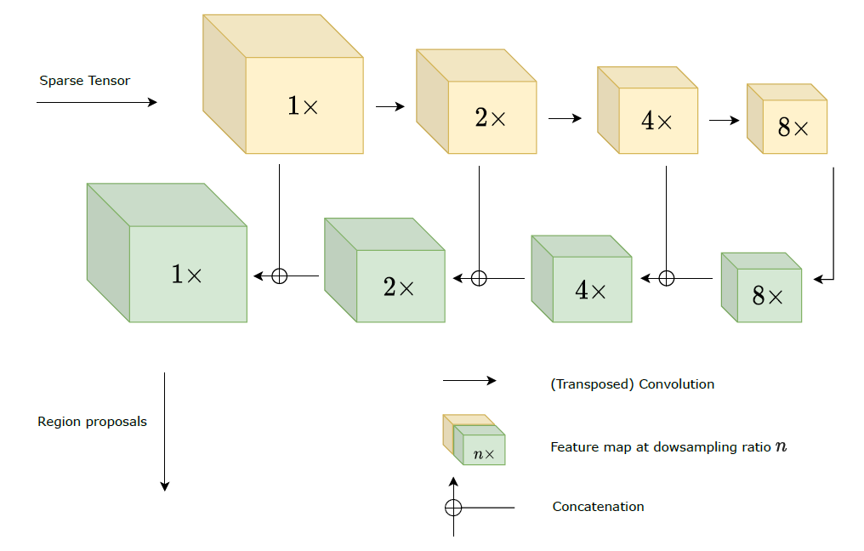
Description of models
PV-RCNN and variants
U-net backbone. In PV-RCNN U-net Dense, a dense (convolution) residual block is placed before the generation of RoIs.
Voxel-based approach for object detection in point clouds

Slide 23
Description of models
PV-RCNN and variants
Results on Sun-RGBD
Method | Bathtub | Bed | Bookshelf | Chair | Desk | Dresser | Nightstand | Sofa | Table | Toilet | mAP
GroupFree3D | 0,80 | 0,88 | 0,33 | 0,80 | 0,33 | 0,36 | 0,67 | 0,70 | 0,54 | 0,91 | 0,63
Votenet | 0,74 | 0,83 | 0,29 | 0,75 | 0,22 | 0,30 | 0,62 | 0,64 | 0,47 | 0,90 | 0,58
DSS (use RGB) | 0,44 | 0,79 | 0,12 | 0,61 | 0,21 | 0,06 | 0,15 | 0,54 | 0,50 | 0,79 | 0,42
PV-RCNN U-net Sparse | 0 | 0,76 | 0,19 | 0,63 | 0,03 | 0 | 0 | 0,54 | 0,18 | 0,74 | 0,31
PV-RCNN U-net Dense | 0,45 | 0,69 | 0,13 | 0,67 | 0,06 | 0,1 | 0,24 | 0,6 | 0,34 | 0,83 | 0,41
Voxel-based approach for object detection in point clouds

Slide 24
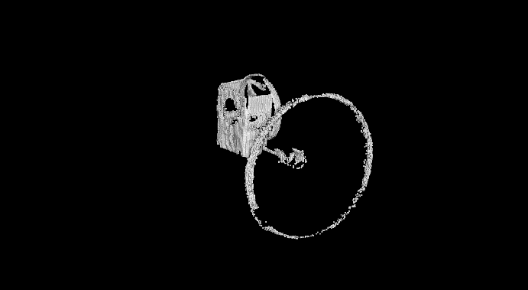
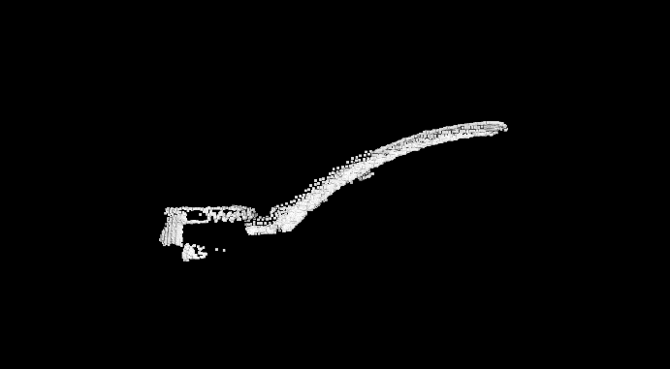
Description of models
PV-RCNN and variants
Results on Chaufferie
Method | Round valves |  | Ball valves |  | All valves
 | AP@0.10 | AP@0.25 | AP@0.10 | AP@0.25 | AP@0.10 | AP@0.25
Vanilla PV-RCNN | 0,57 | 0,52 | NA | NA | NA | NA
PV-RCNN U-net Dense | 0,84 | 0,84 | 0,30 | 0,05 | 0,68 | 0,36
Voxel-based approach for object detection in point clouds

Slide 25
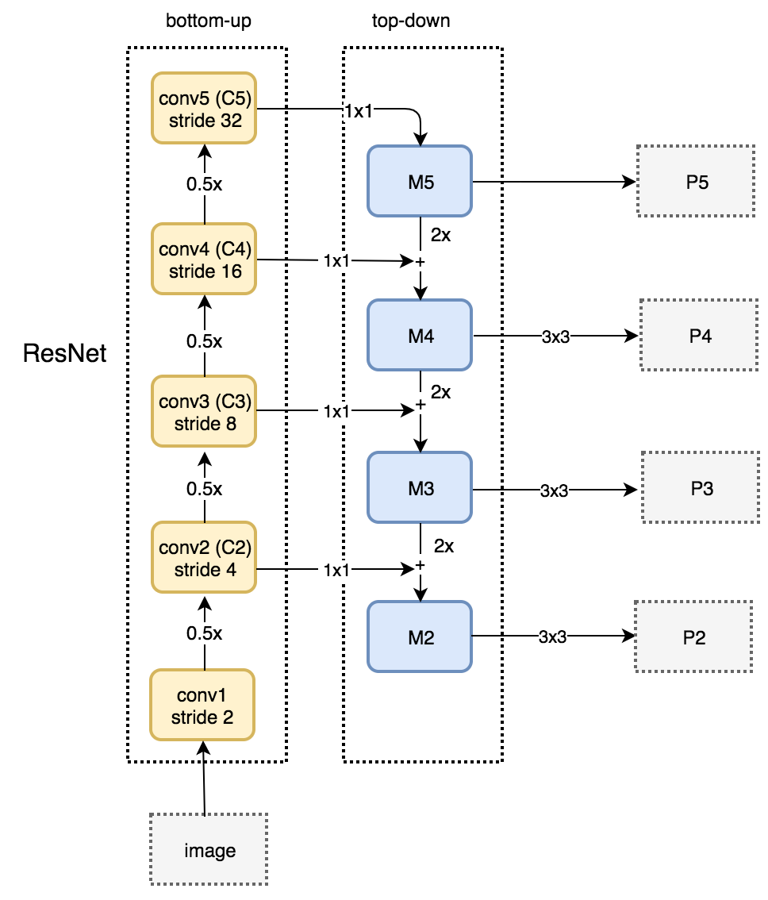
Description of models
Implementation of GSDN
GSDN architecture
FPN down to stride 32.
Source: Understanding Feature Pyramid Networks for object detection (FPN) | by Jonathan Hui | Medium
Voxel-based approach for object detection in point clouds

Slide 26
Description of models
Implementation of GSDN
Results on Sun-RGBD
Method | Bathtub | Bed | Bookshelf | Chair | Desk | Dresser | Nightstand | Sofa | Table | Toilet | mAP
GroupFree3D | 0,80 | 0,88 | 0,33 | 0,80 | 0,33 | 0,36 | 0,67 | 0,70 | 0,54 | 0,91 | 0,63
Votenet | 0,74 | 0,83 | 0,29 | 0,75 | 0,22 | 0,30 | 0,62 | 0,64 | 0,47 | 0,90 | 0,58
DSS (use RGB) | 0,44 | 0,79 | 0,12 | 0,61 | 0,21 | 0,06 | 0,15 | 0,54 | 0,50 | 0,79 | 0,42
PV-RCNN U-net Sparse | 0 | 0,76 | 0,19 | 0,63 | 0,03 | 0 | 0 | 0,54 | 0,18 | 0,74 | 0,31
PV-RCNN U-net Dense | 0,45 | 0,69 | 0,13 | 0,67 | 0,06 | 0,1 | 0,24 | 0,6 | 0,34 | 0,83 | 0,41
GSDN | 0,58 | 0,83 | 0,01 | 0,56 | 0,10 | 0,03 | 0,37 | 0,56 | 0,35 | 0,81 | 0,44
Voxel-based approach for object detection in point clouds

Slide 27
Plan
Literature review
Data analysis and processing
Description of models
Qualitative results
Voxel-based approach for object detection in point clouds

Slide 28
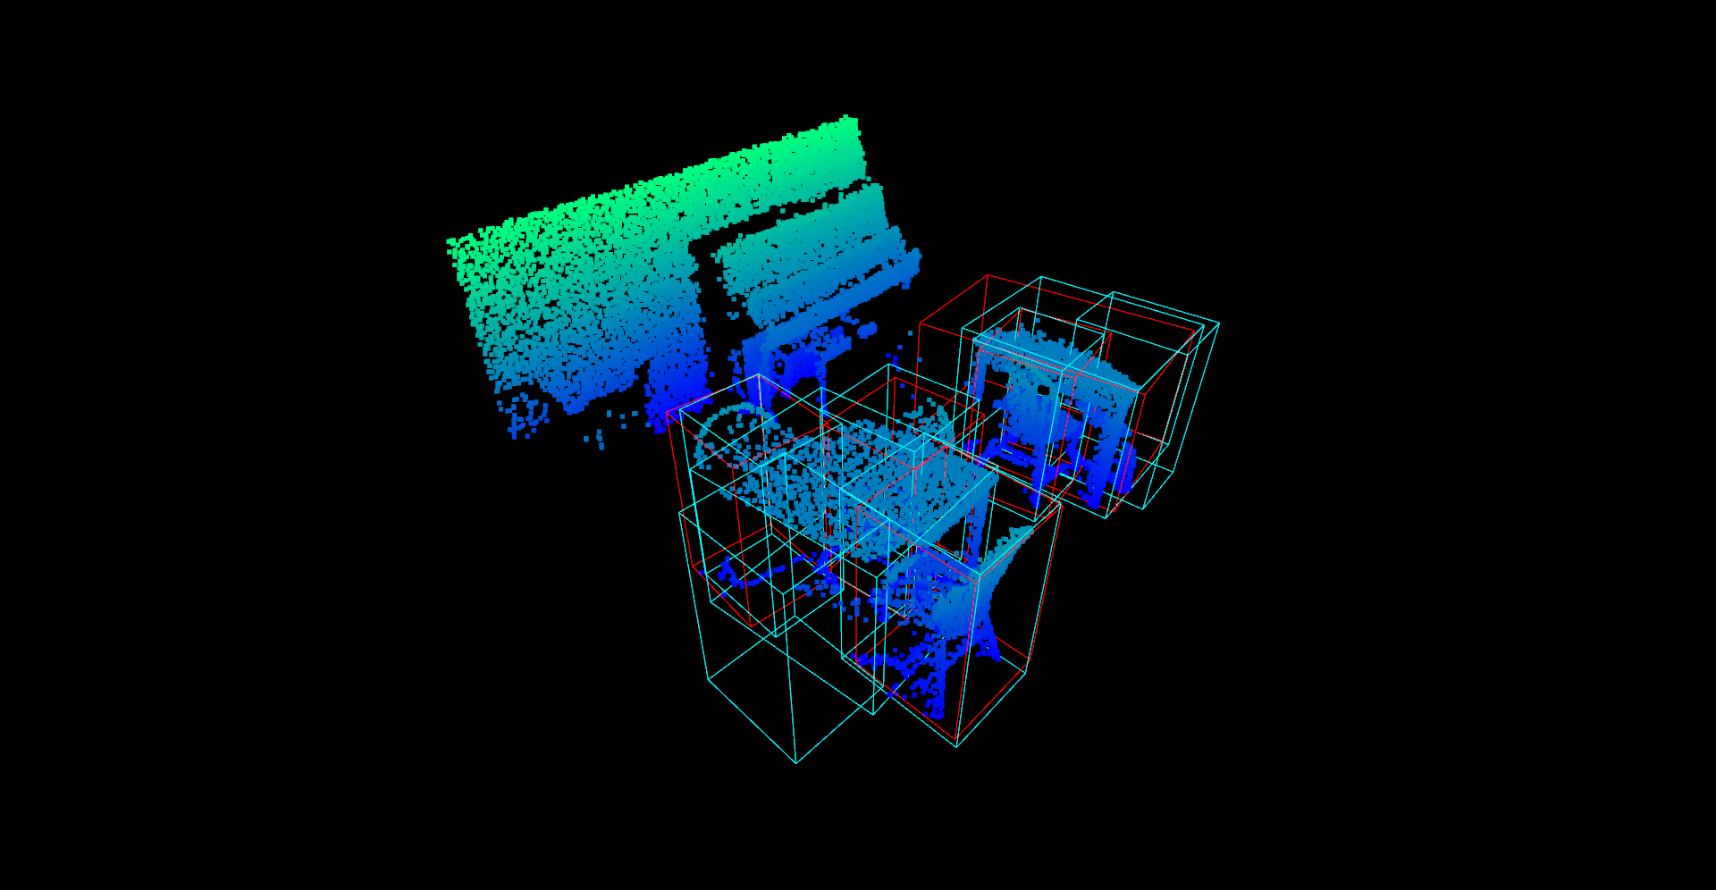
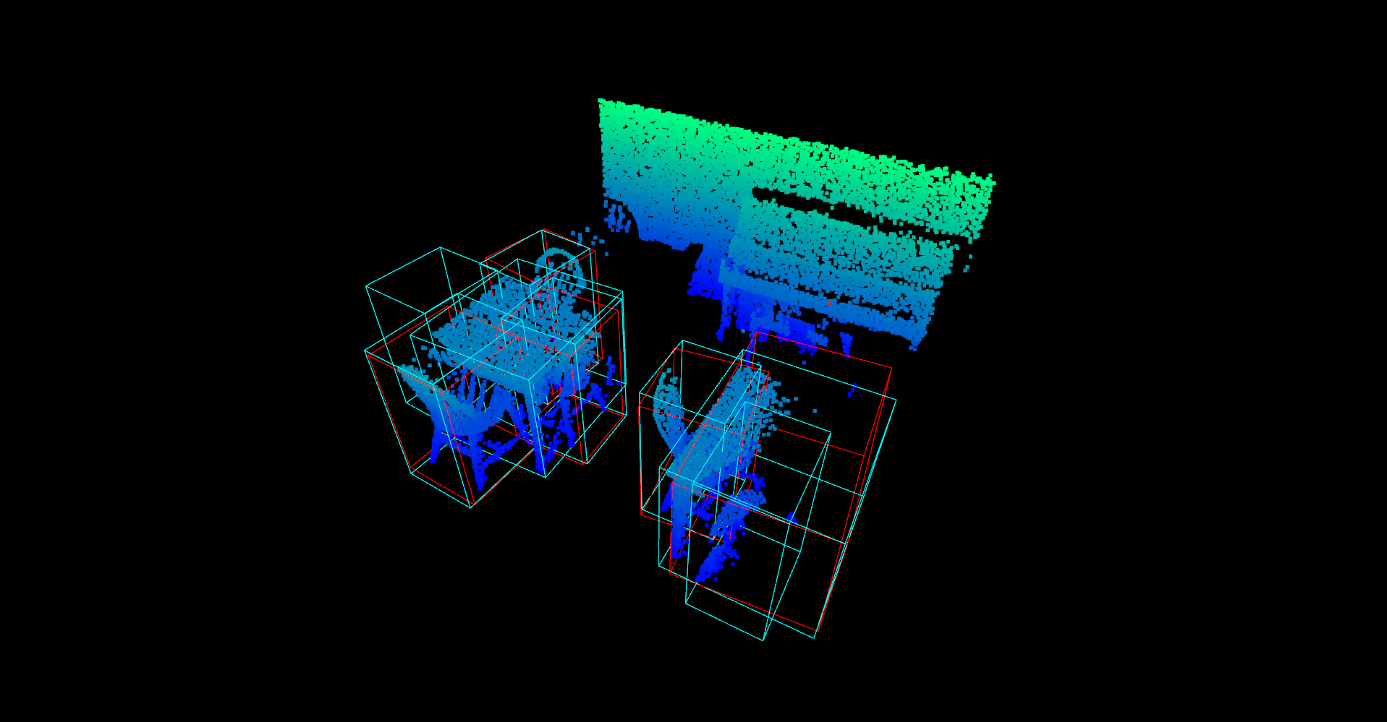
Qualitative results
Qualitative results of PV-RCNN U-net Dense on Sun-RGBD
Voxel-based approach for object detection in point clouds

Slide 29
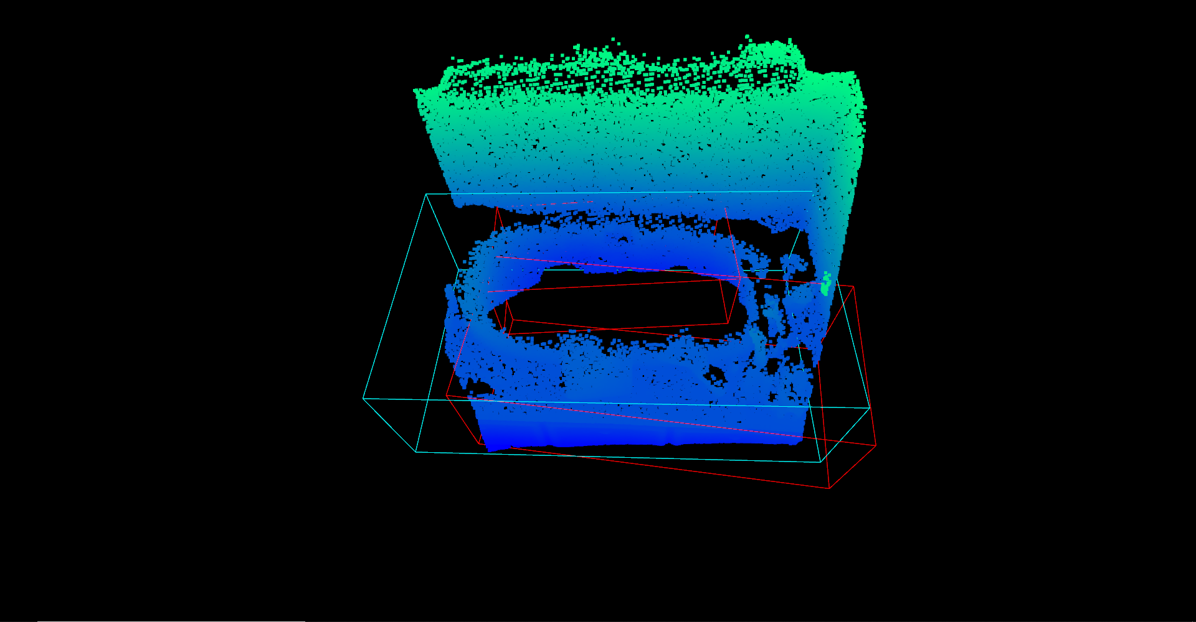
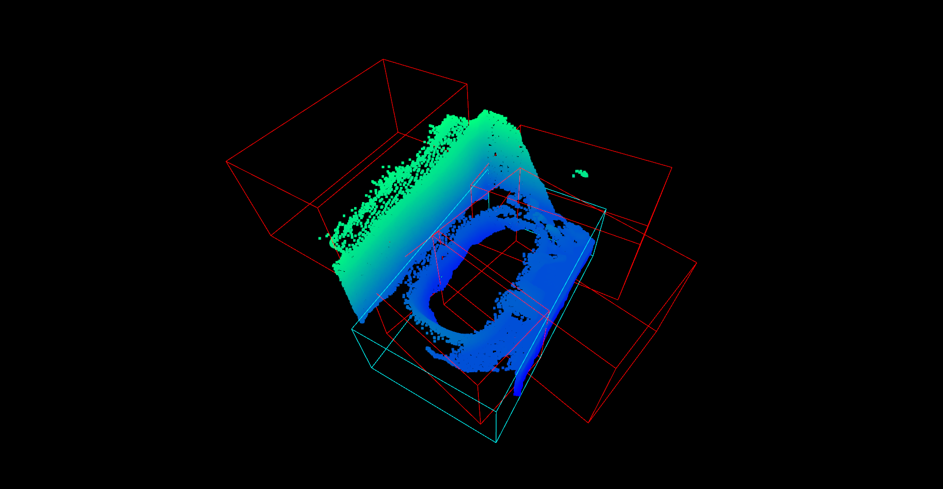
Qualitative results
Comparison between PV-RCNN U-net Dense (Left) and Sparse (Right) on an example of bathtube class
Voxel-based approach for object detection in point clouds

Slide 30
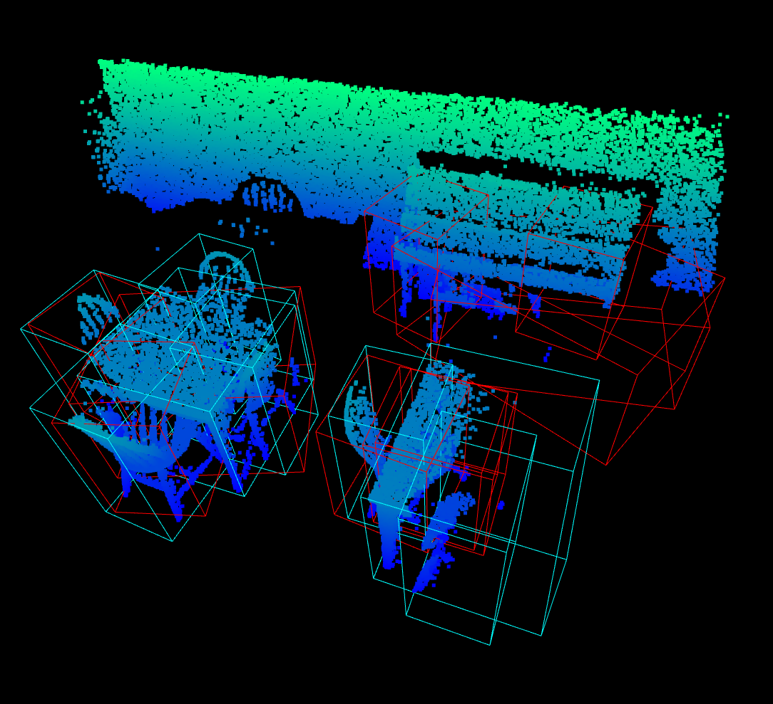
Qualitative results
Comparison between PV-RCNN U-net Dense (Left) and GSDN (Right) on Sun-RGBD. GSDN does not require to crop the scene to fit it in a 3D grid
Voxel-based approach for object detection in point clouds

Slide 31
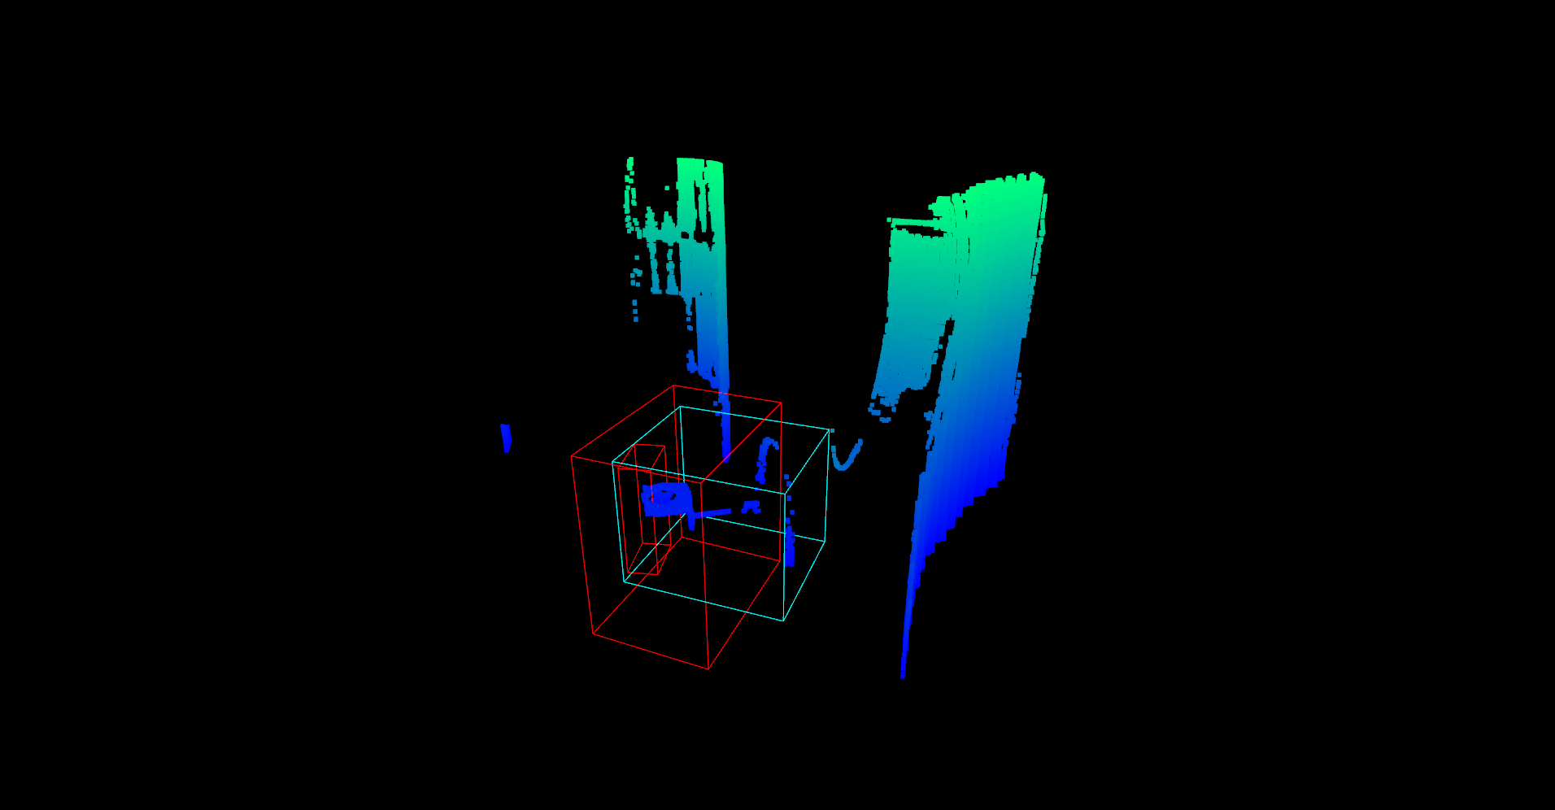
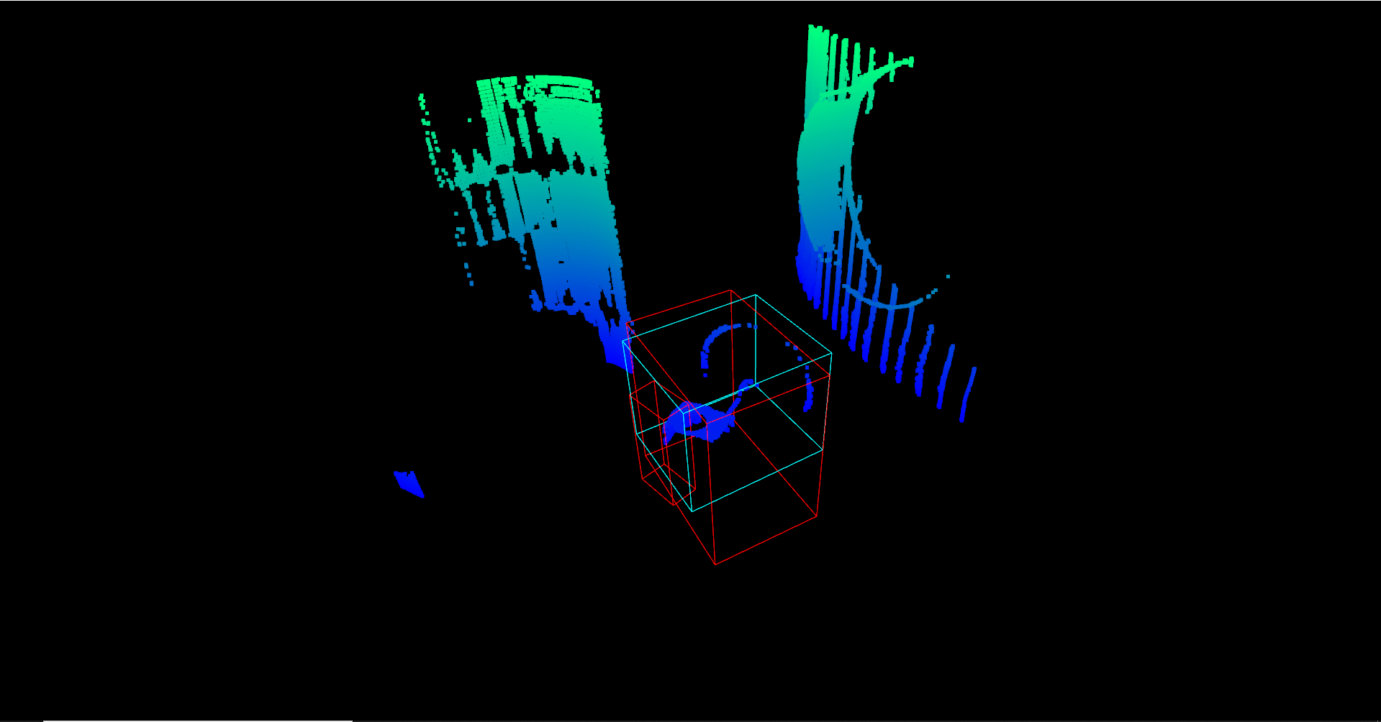
Qualitative results
PV-RCNN U-net Dense on Chaufferie
Voxel-based approach for object detection in point clouds

Slide 32
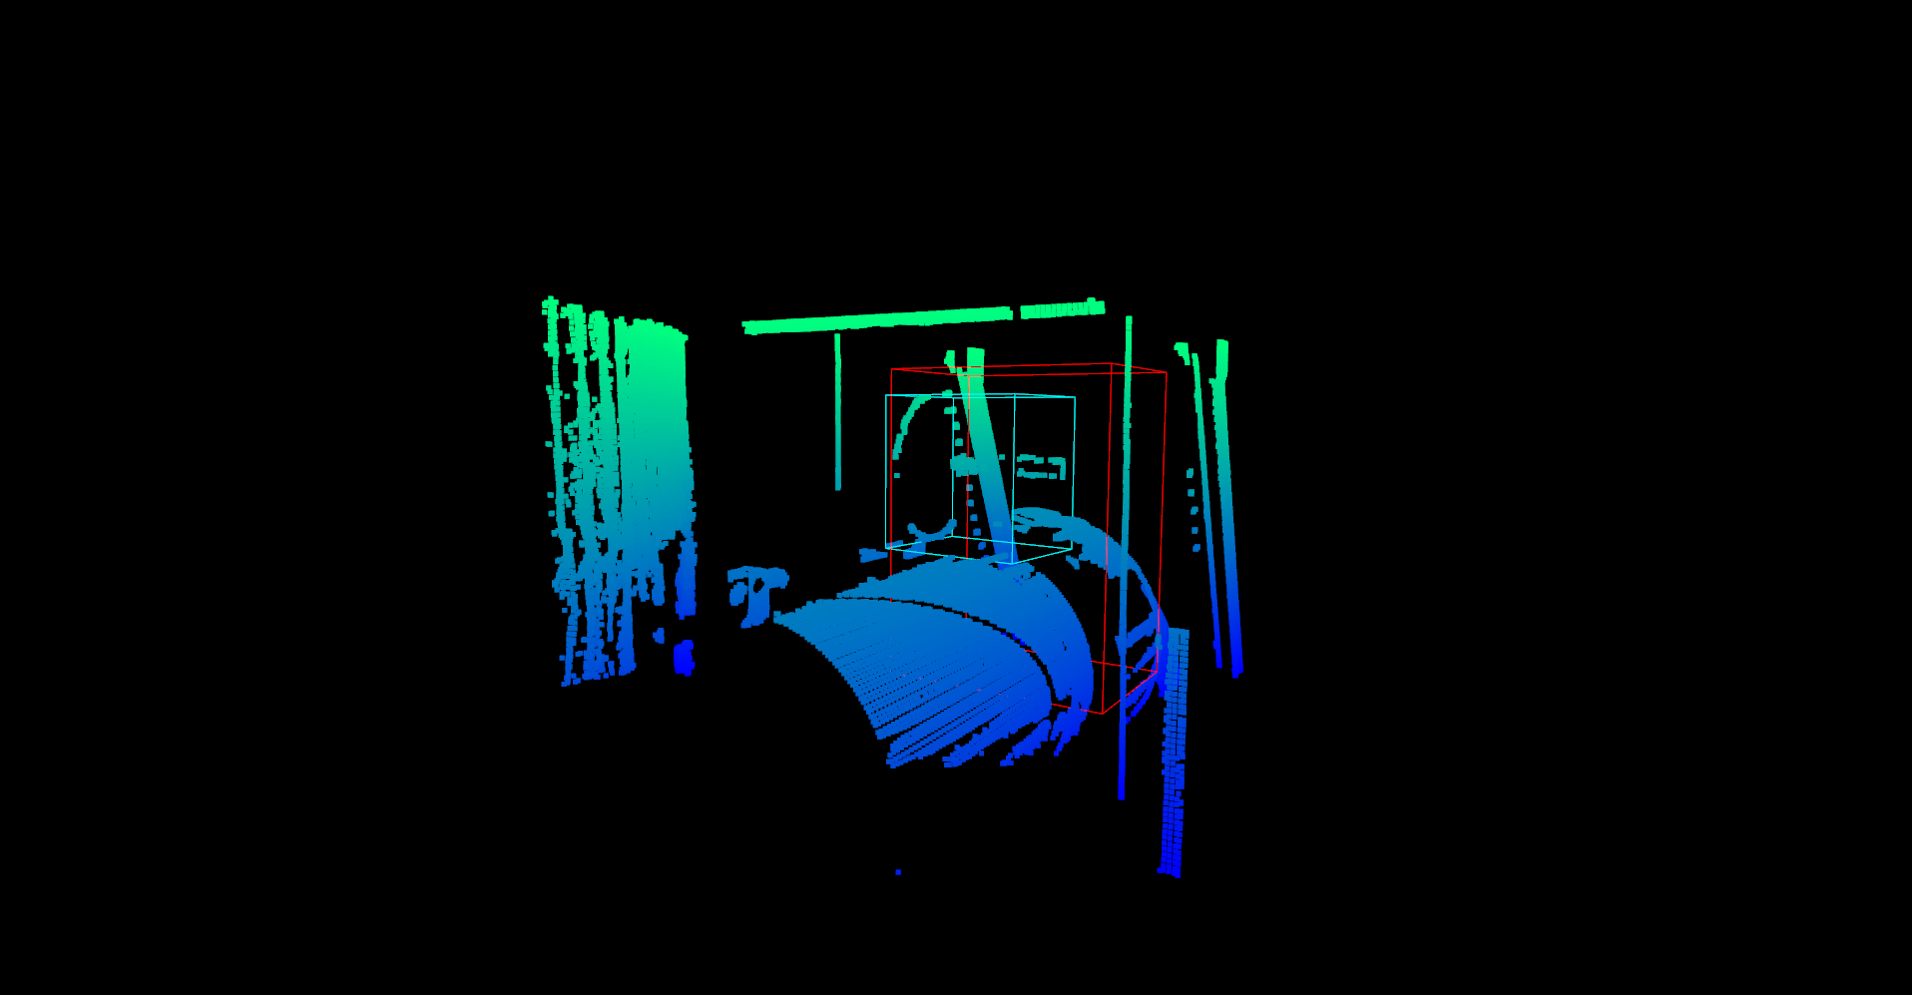
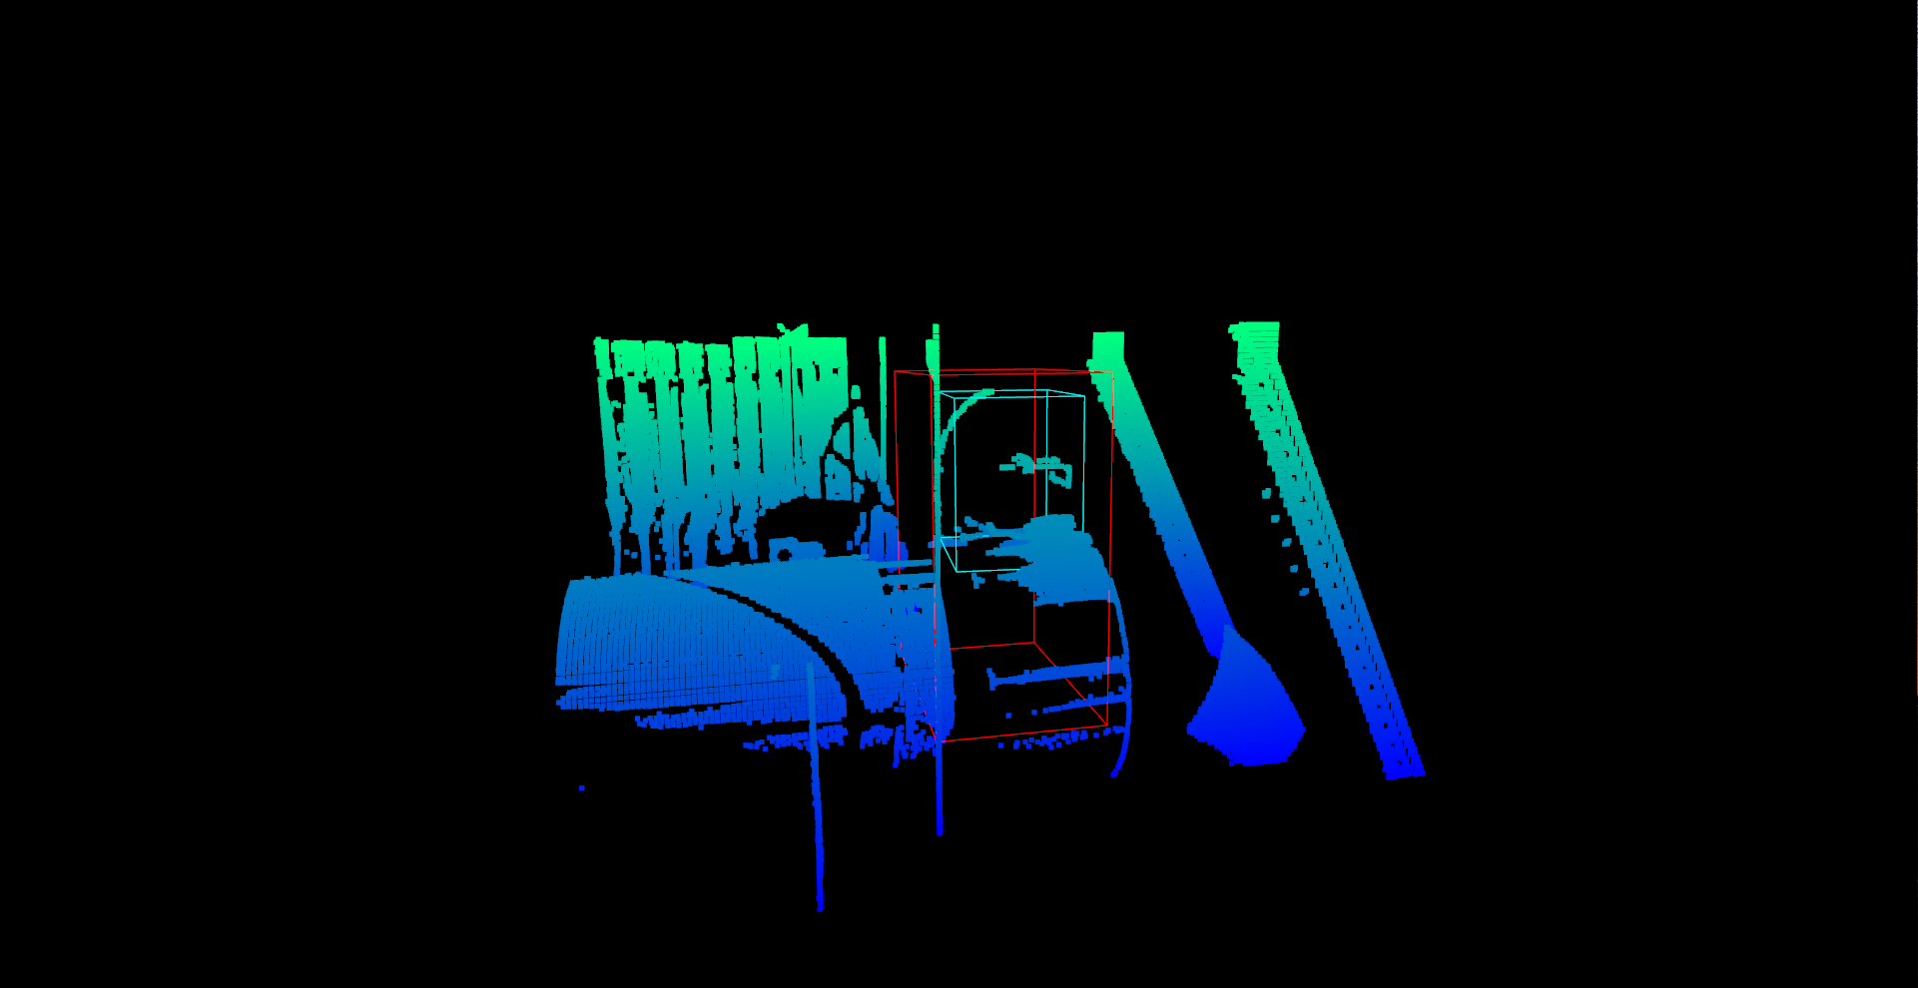
Qualitative results
PV-RCNN U-net Dense on Chaufferie
Voxel-based approach for object detection in point clouds

Slide 33
Plan
Literature review
Data analysis and processing
Description of models
Qualitative results
Conclusion
Voxel-based approach for object detection in point clouds

Slide 34
Conclusion
Although Sparse convolution can handle the sparsity of data, for object detection task, it is required to infer Points/Voxels of Interest that do not belong to raw data (GSDN, Votenet).
Future work may involve in:
The use of RGB colors of points
The exploitation of anchor-free detectors
Voxel-based approach for object detection in point clouds

Slide 35
Thanks for your attention

